Slide 1
Dos and Don’ts for computational training
Sara El-Gebali
@yalahowy

Slide 2
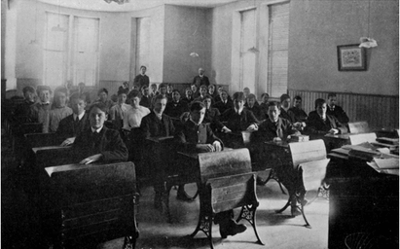
Evolution of training

Slide 3
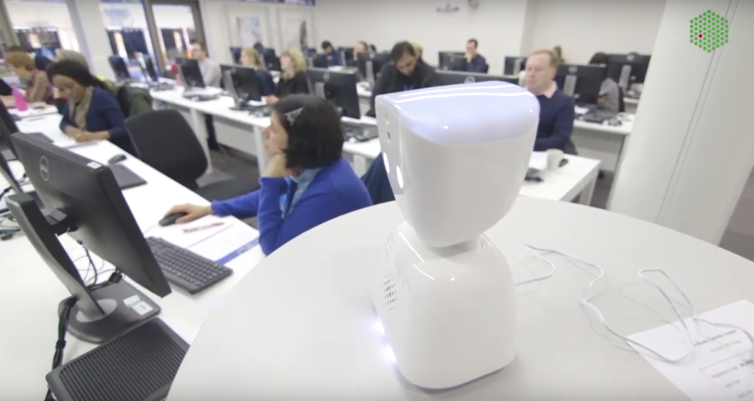
Remote participation of students abroad

Slide 4
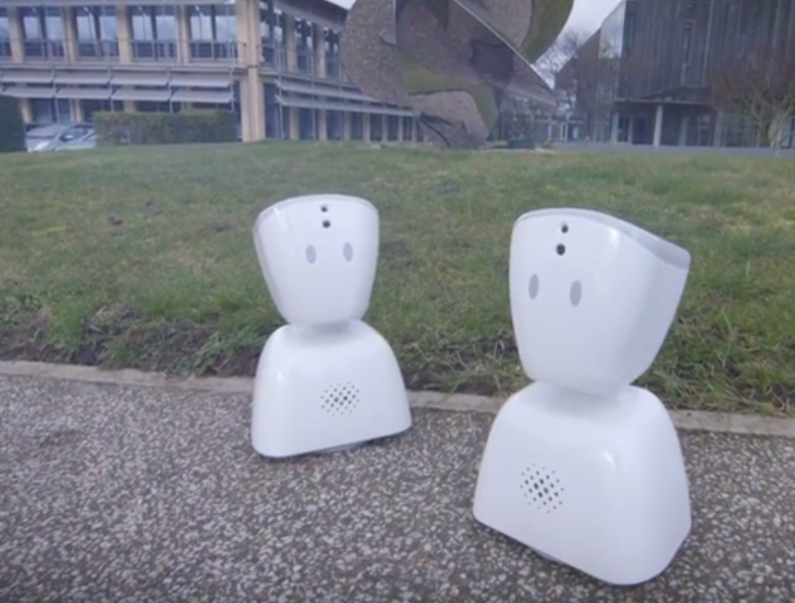
Networking and Community building

Slide 5
Agenda
Fill in Audience Survey (http://tiny.cc/ccmcr19)
Brief discussion what to do next
Group work
Discussion
Feedback Survey and Wrap up

Slide 6
http://tiny.cc/dosdiscussion
Discussion points

Slide 7
http://tiny.cc/dosfeedback
https://docs.google.com/forms/d/1KgpRoxt1TuX_2tft0SbKgHWMipx1H8UVUxekhkMQWaA/edit
Survey and Feedback

Slide 8
Files
Presentation
Audience intro + Group input
Discussion points
Feedback survey.

